Slide 1
Topic Model for the Letters of Vincent van Gogh

Slide 2


Slide 3
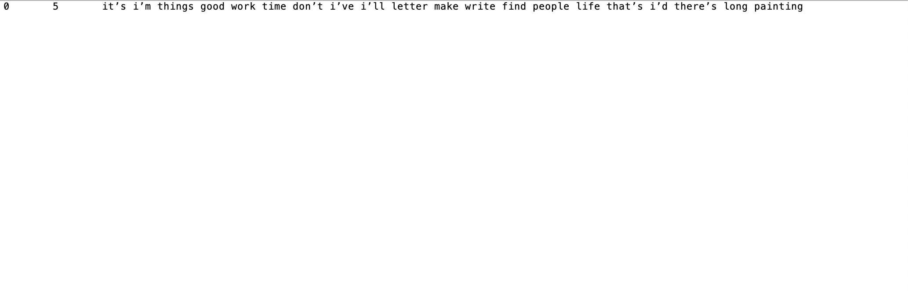
1 Topics(Full Corpus)

Slide 4
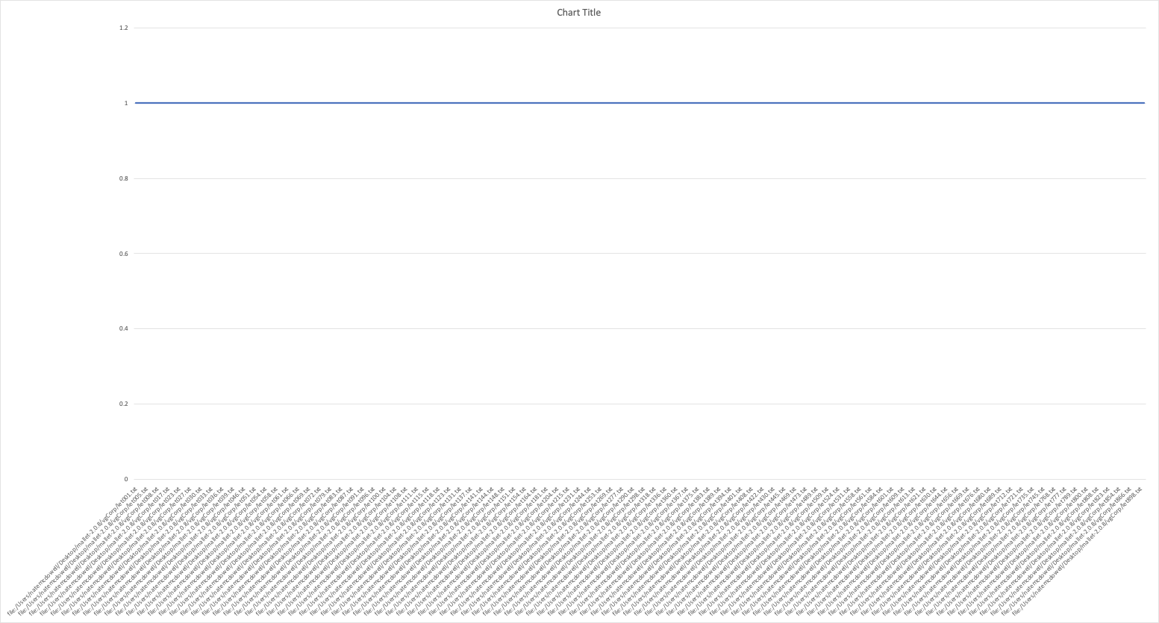
Graphed

Slide 5
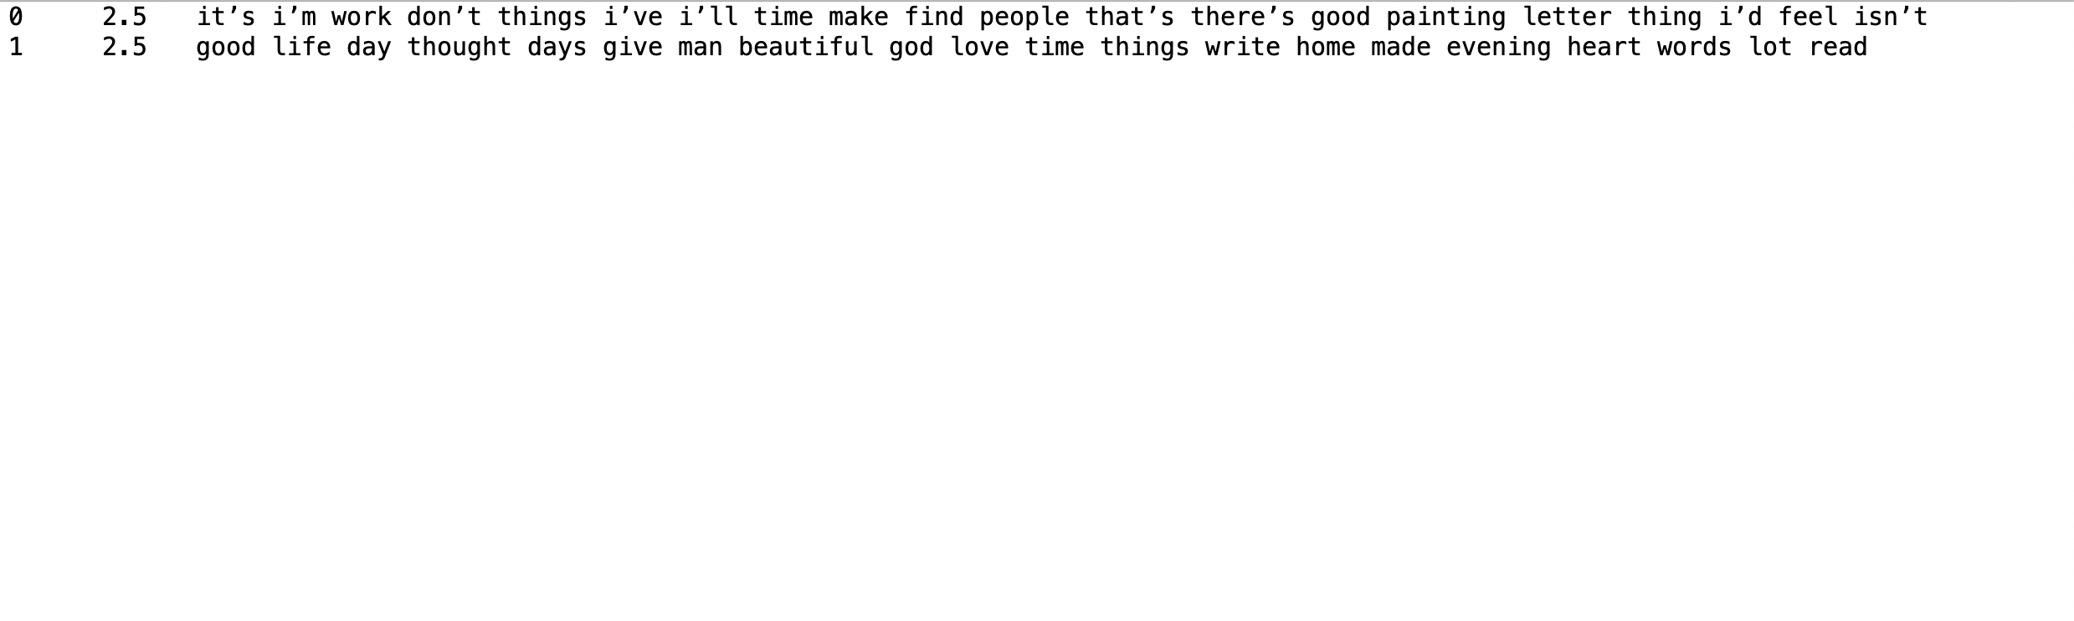
2 Topics(Full Corpus)

Slide 6
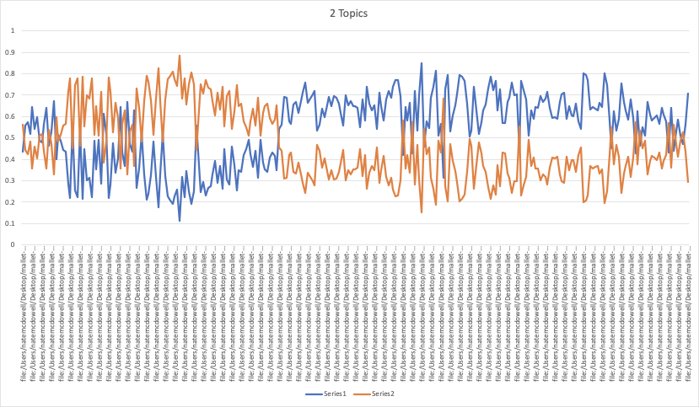

Slide 7
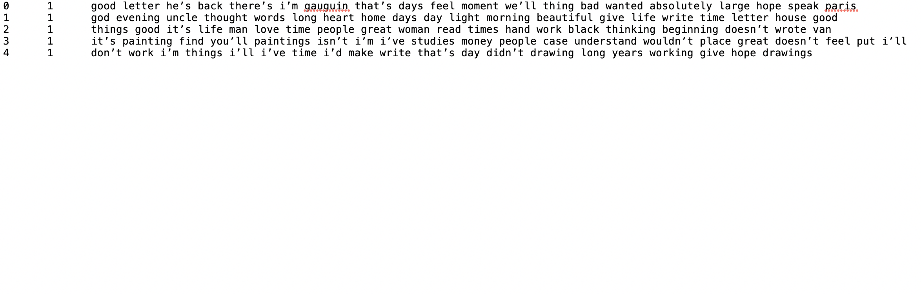
5 Topics

Slide 8
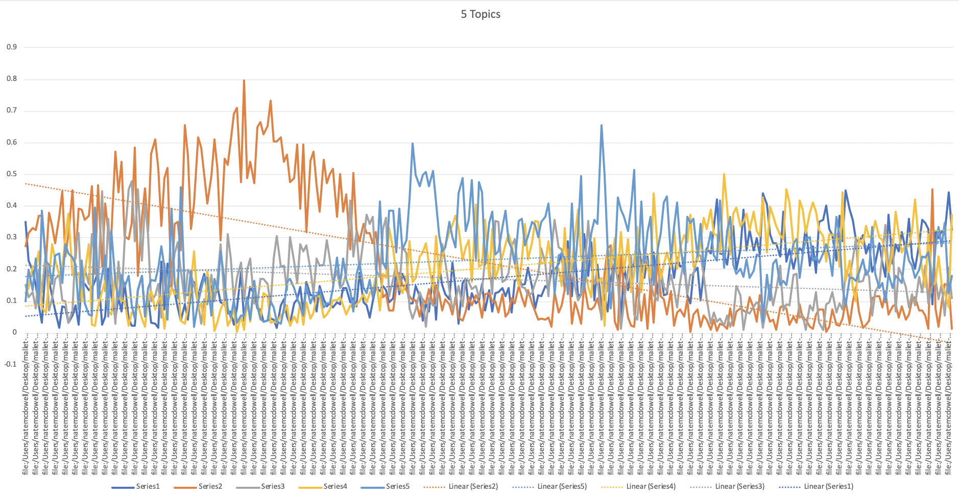

Slide 9
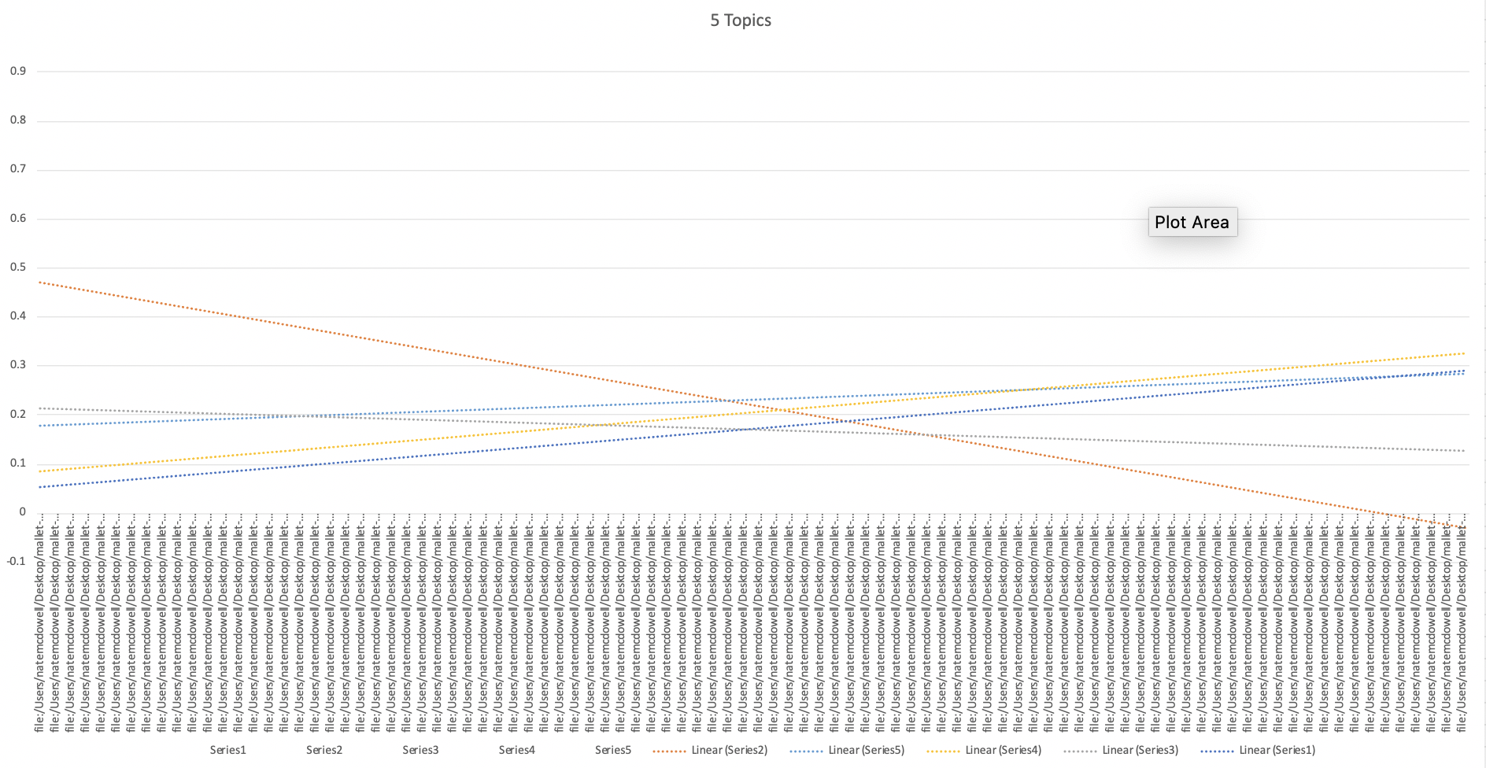

Slide 10
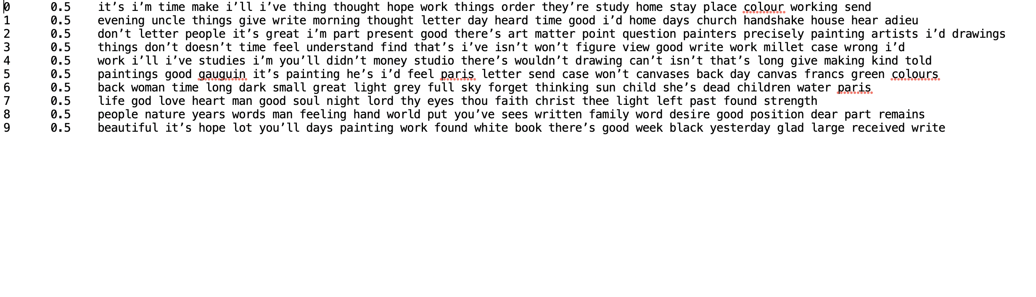
10 Topics

Slide 11
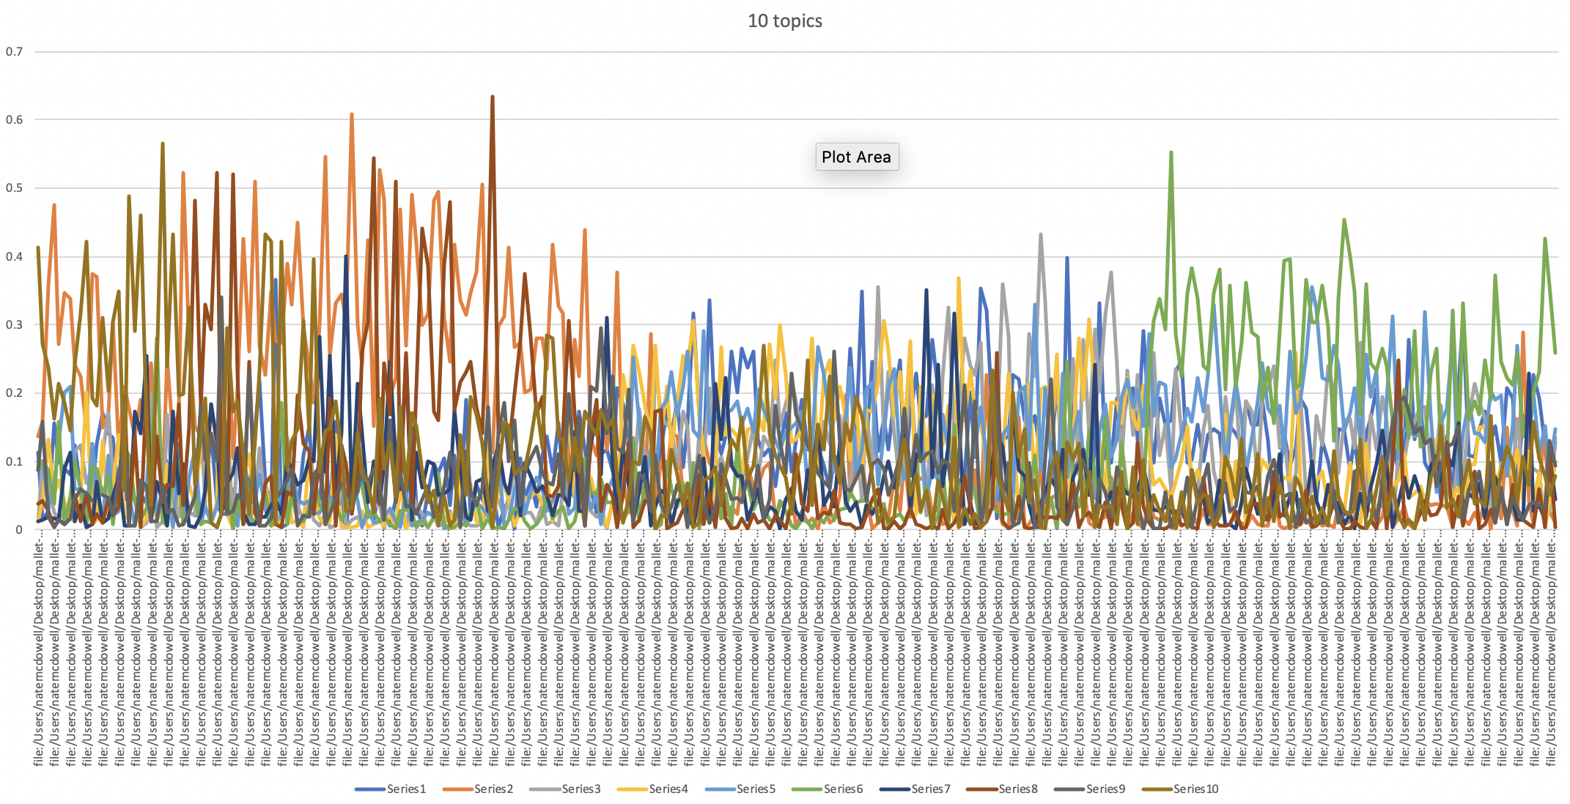

Slide 12
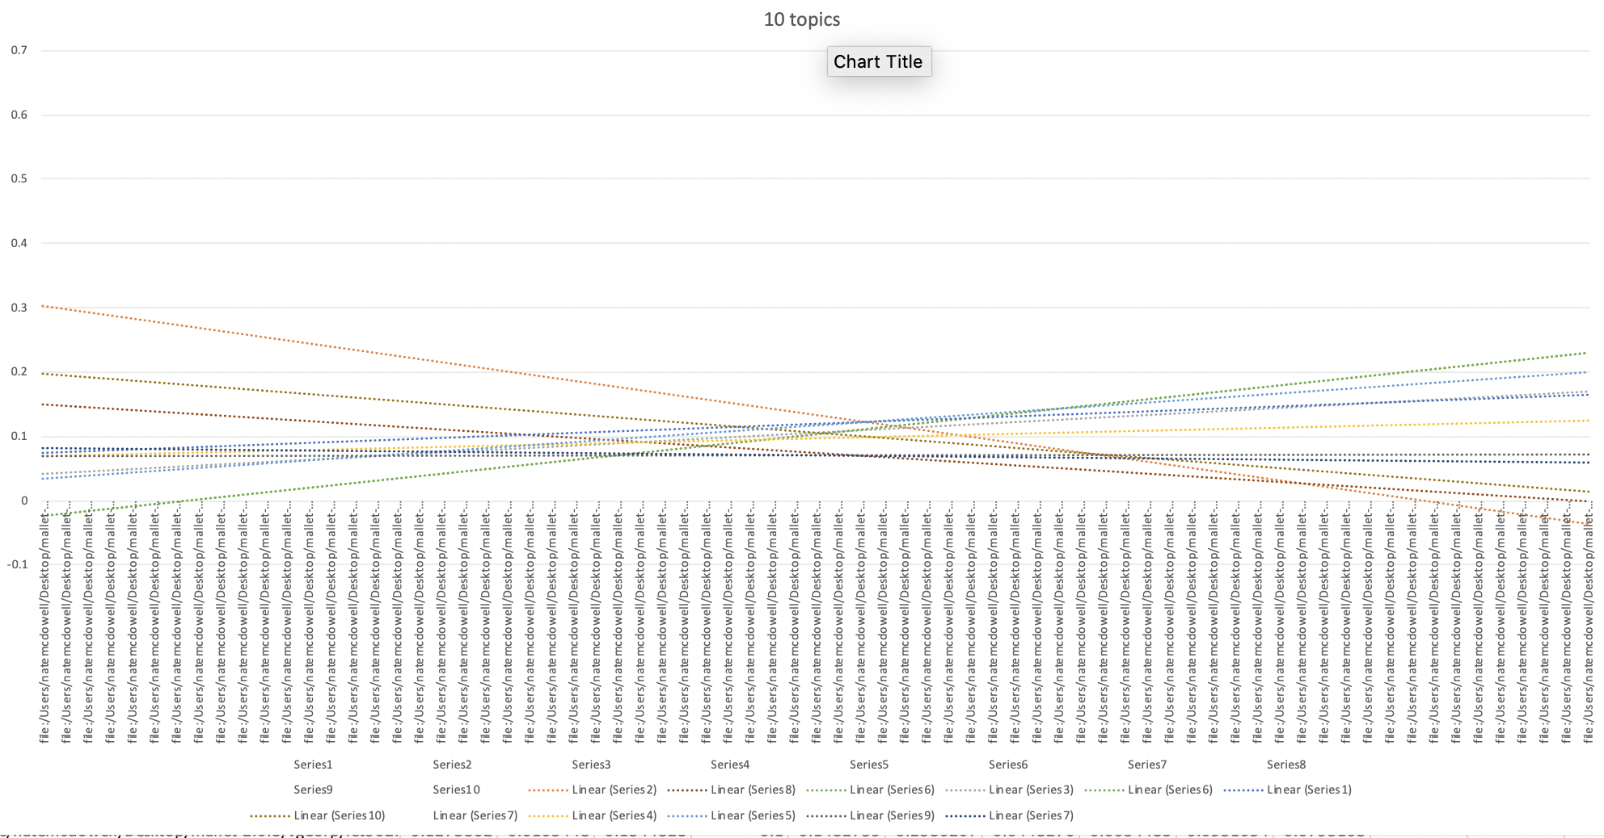

Slide 13
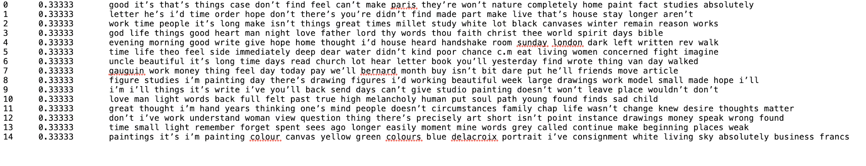
15 Topics

Slide 14
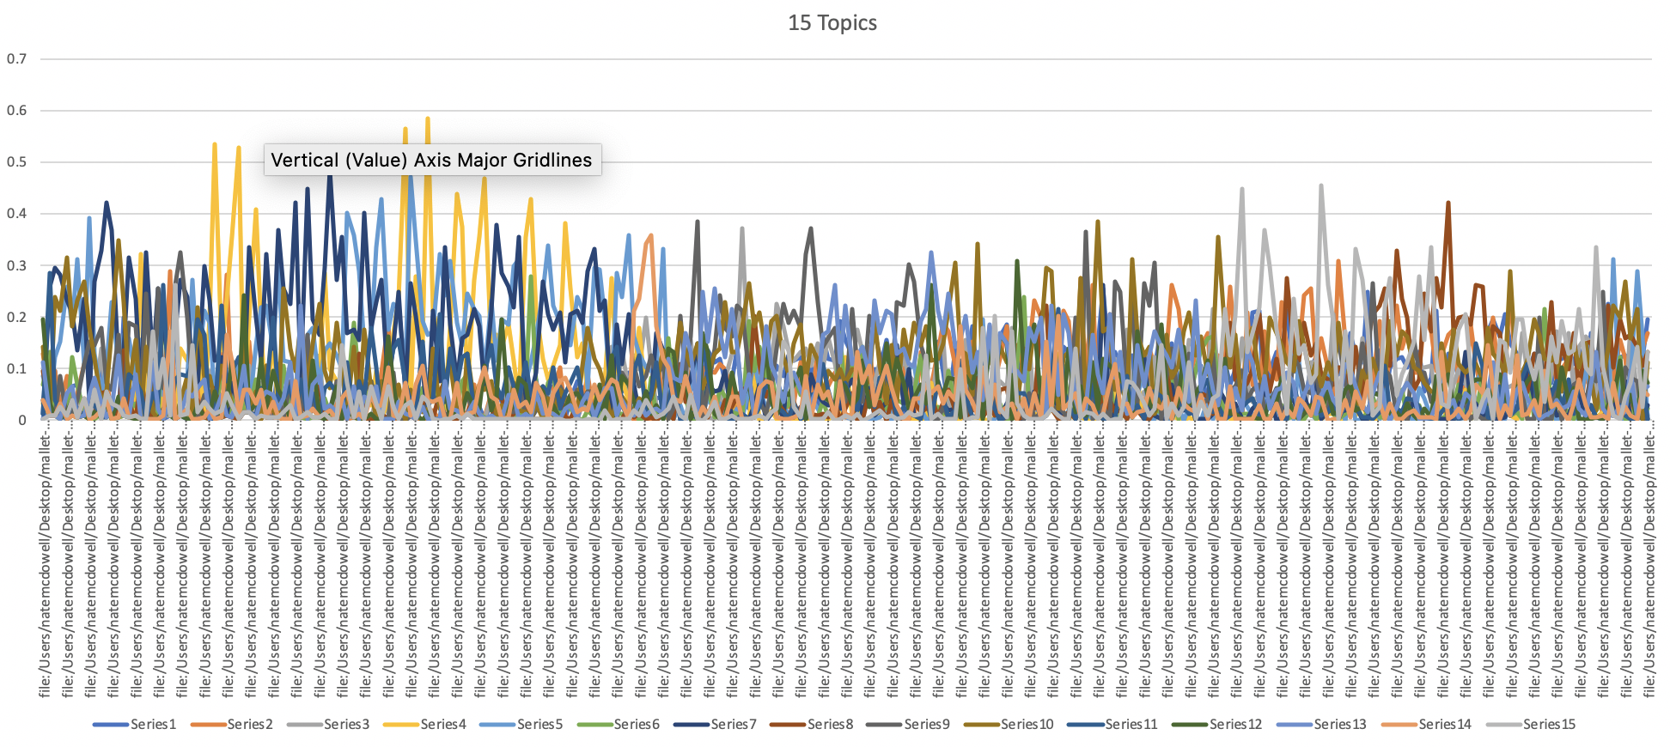

Slide 15
Testing iterations on 10 topics

Slide 16
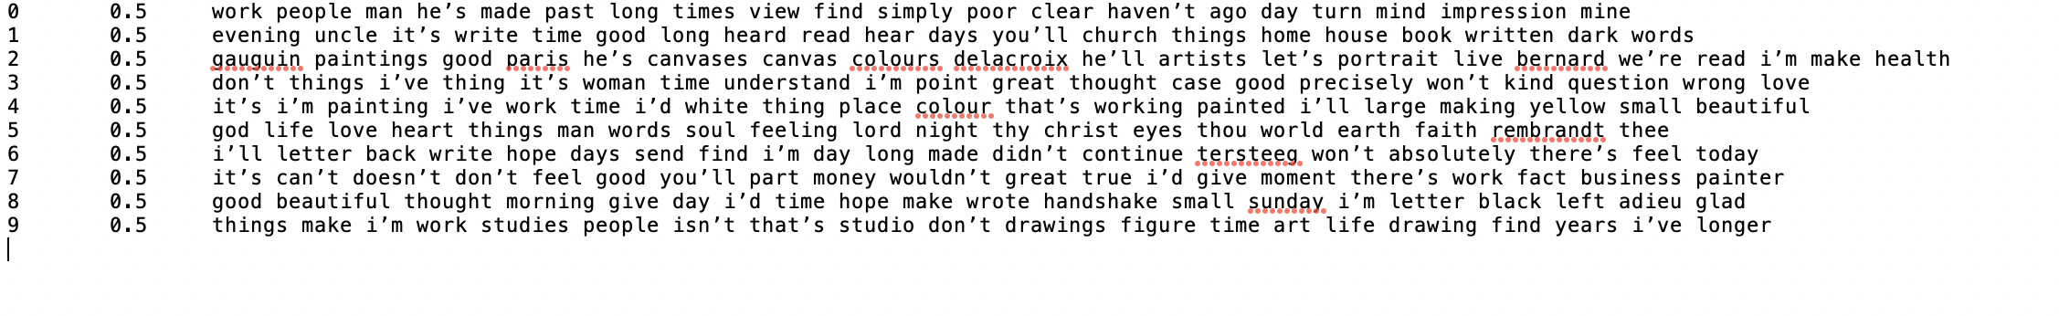
100 Iterations

Slide 17
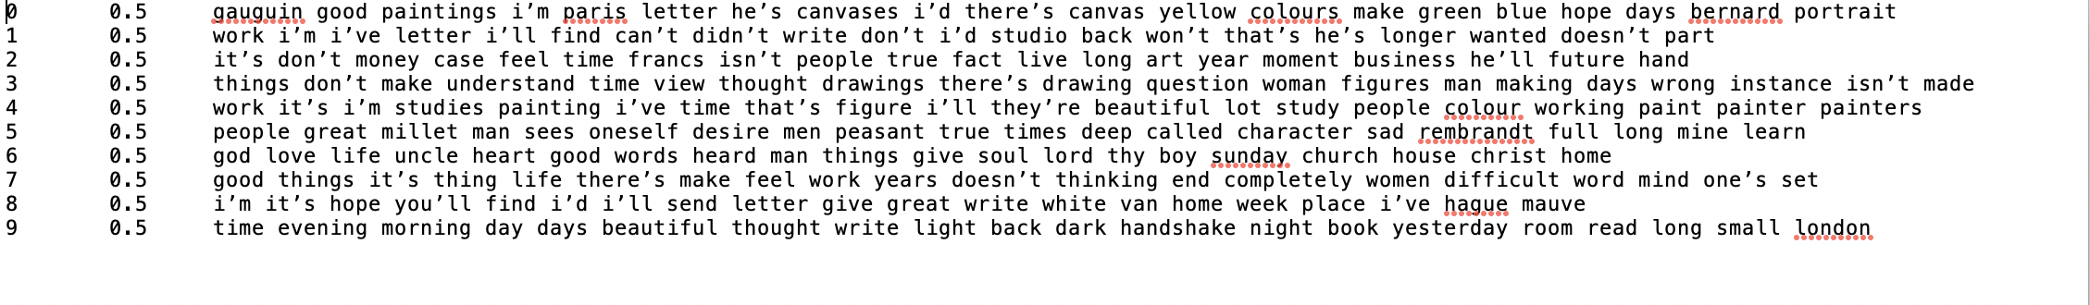
200 iterations

Slide 18
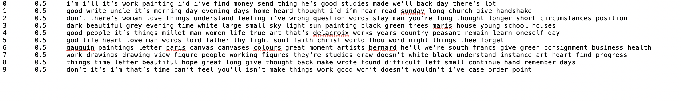
300 Iterations

Slide 19
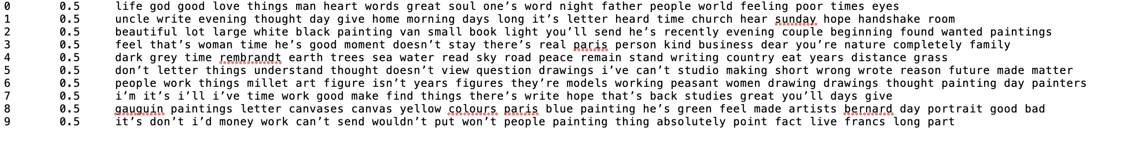
400 Iterations
I like this result. It seems to me the categories are getting more specific with additional iterations. For example compare line 5 here and line 4 on the previous slide.

Slide 20
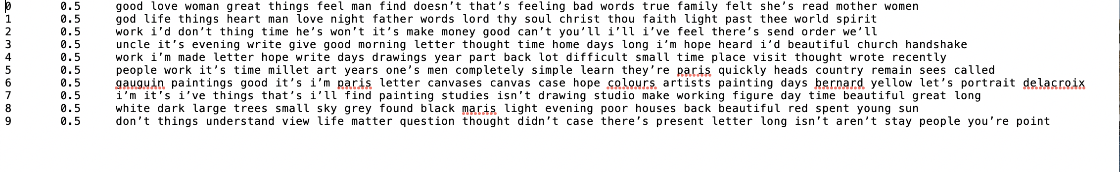
500 iterations

Slide 21
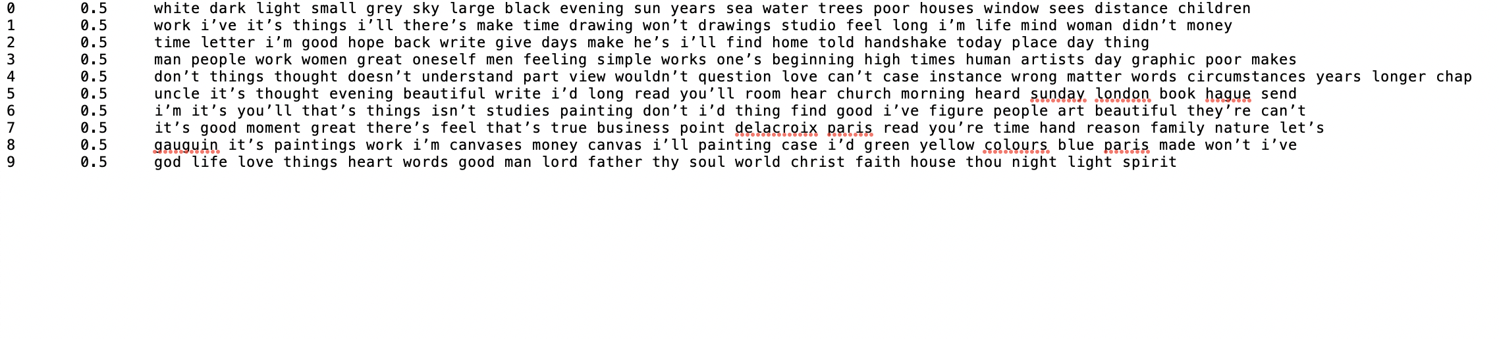
600 iterations

Slide 22
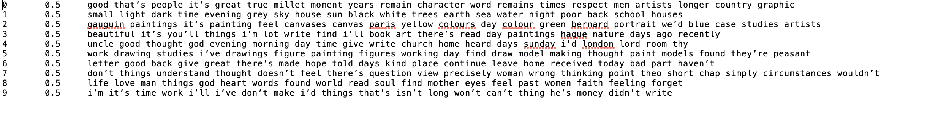
700 iterations

Slide 23
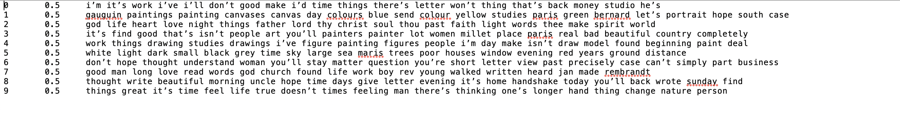
800 iterations

Slide 24
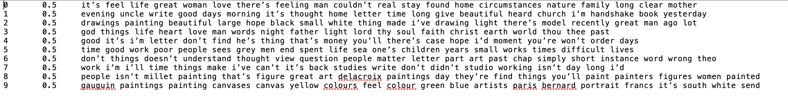
900 iterations

Slide 25
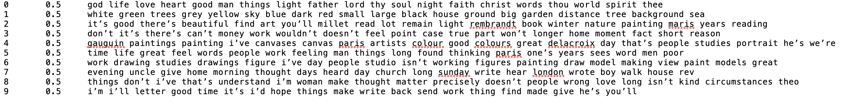
1000 iterations

Slide 26
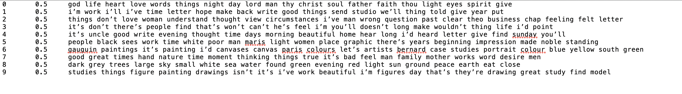
2000 iterations

Slide 27
Next tasks
Run each time period through mallet separately and compare the topics that are generated
Successfully exclude non-informative words
Generate a list of words that we want to enter into MALLET to gather results for document classification
Document Classification
http://mallet.cs.umass.edu/ge-classification.php
“Suppose we know a priori that the words baseball and puck are good indicators of labels baseball and hockey respectively. Specifically, suppose that we estimate that 90% of the documents in which the word puck occurs should be labeled hockey, and similarly for baseball. We may specify these constraints in a file as follows.”

